Slide 1
Universal Supports for Online Testing
Classroom Teachers, Test Administrators
Notes:
Hi, SC Educators!
This resource is intended for use by teachers with the goal of familiarizing students with the online tools available to all students on SC READY and End-of-Course exams. It is important that students understand how to use these tools and practice using them prior to taking the test. Repeated practice with these tools will enhance their effectiveness and may result in more valid test scores that accurately reflect student knowledge.
The first three slides are for teacher information only. The lesson begins with the agenda on slide 3. A script will be provided in the notes for each slide.

Slide 2

Materials for Optional Activities (one per student)
Highlighters
Rulers/bookmarks/pipe cleaners (to be used as line guides/masks)
Blank paper
Pencils or pens
Selected passages from Sample Items for SC READY and EOCEP
Notes:
Prior to delivering this lesson:
Review the PowerPoint to familiarize yourself with the content and hide any slides that are not relevant to your students.
Gather necessary materials for optional activities, including the sample test questions that are appropriate for your students (Sample Items for SC READY and EOCEP). You will need to select:
multiple-choice examples that can be very short for some of the activities (i.e., “cross-off”) and
a sample question that includes a longer passage for practice with tools such as “line guide” and “masking”.
Consider how you will use this resource. You can share all tools in one lesson or break the content up over several sessions, unpacking and practicing each tool separately or a few at a time.
This PowerPoint includes two distinct parts for each tool:
Direct instruction in the purpose and use of the online tool
Practice using the tool in a non-digital format
This is meant to facilitate greater understanding of the purpose of each tool and provide students with practice using the tool in another way, which can transfer to use in the classroom setting.
After this lesson, please have your students go to https://portal.te.drcedirect.com/SC , choose either SC READY or EOCEP, then choose “Online Tools Training” to practice using the tools in the online test format.
There are several benefits to this instruction:
Instruction and practice will make it more likely that the students will access the tools for their appropriate use during testing.
Repeated practice will make it more likely that students will truly benefit from use of the tools.
Having these tools available to all students removes the stigma of using them. Students are not singled out as different from their peers for utilizing specific accommodations, so they are more likely to take advantage of the support these tools offer.

Slide 3
Agenda
Introduction to the built-in online tools
Practice using the tools
Resources
Notes:
Teachers – from here on, a script will be provided in the notes. A print version of the script is provided with this resource.
Read aloud what is printed in bold type following the word “SAY”. Do not read aloud text that is printed in plain type. You may repeat directions, as needed. As this is training and practice, you may provide additional explanation and instruction, as needed.
SAY: This lesson will help you better understand what tools are available for you when you take SC READY later this year. I will tell you about each of the tools, show you how to use them, and then we’ll practice using the tools. I will show you how to use the tools on the test and we will also practice using the test-taking strategies outside the test, so you will be able to use them in your classwork and homework, as well.

Slide 4
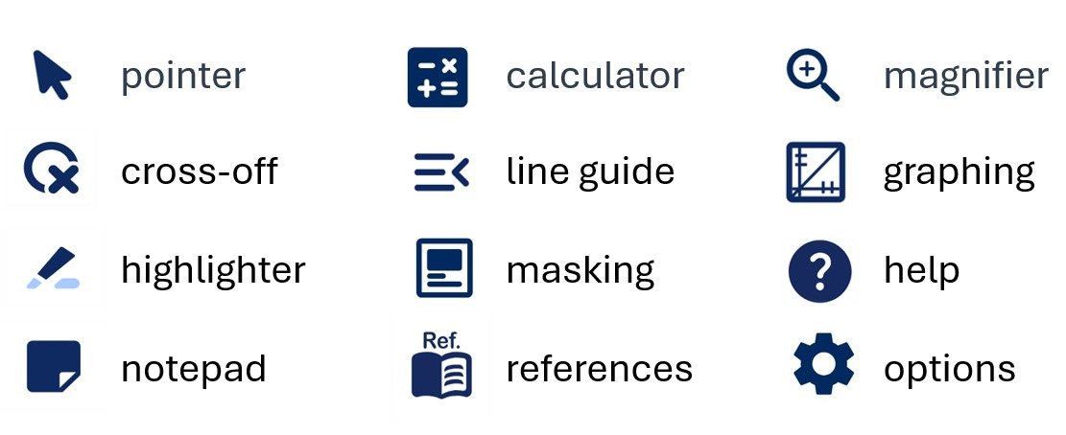


Universal Support Tools
Notes:
SAY: There are several tools available to you when you take SC READY. This lesson will show you how those tools work so you will be able to use them. While you may be familiar with some of the tools, such as the "pointer" or the "calculator", other tools may be new to you. These are tools that you may find available on other digital activities you do in class​. You do not have to use these tools, but they are there to help you.

Slide 5

Pointer
Use the pointer to select things on the screen.
Notes:
SAY: Let’s start with the "pointer". The "pointer" is an arrow that shows you where you are on the screen. You can move the "pointer" with your mouse or touchpad. You can use it to select actions, such as opening or closing tools, or to choose an answer. To make a selection, click the mouse or press the "Enter" key.

Slide 6
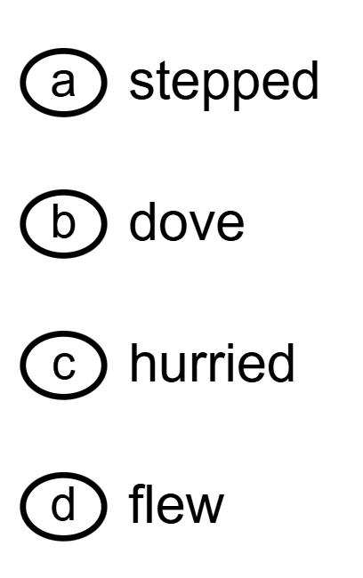


Cross-Off
Use the cross-off tool to mark off answer choices that you have ruled out.
Notes:
SAY: The next tool we’ll discuss is the "cross-off" tool. Use the "cross-off" tool to mark off answer choices that you have ruled out.

Slide 7
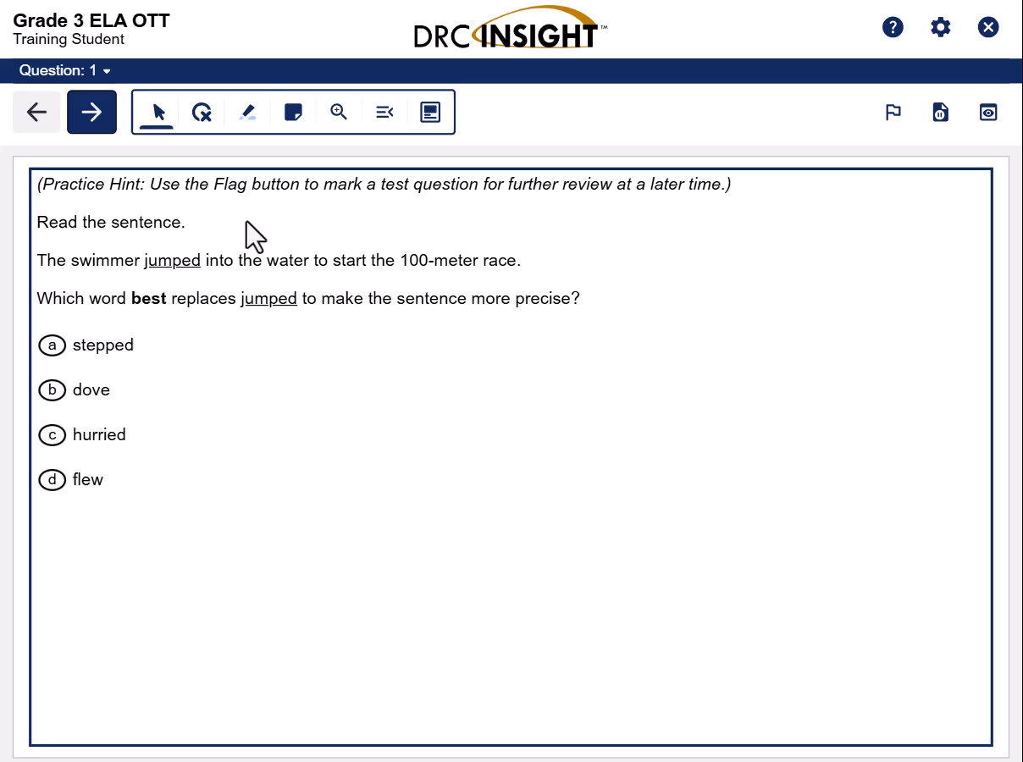
Tool Demo:
Cross-Off
Notes:
Teacher: Press play for video.
Video transcript:
To use the "cross-off" tool, select the "cross-off" button. The "cross-off" tool appears as a finger pointer on your screen. Left click on your mouse to place an "X" on the answer choice you believe is not correct. If you want to remove the "X", simply click on the answer again and it will disappear. You do not need to remove the "X" to move forward in the test.
To stop using the "cross-off" tool, click the "cross-off" button again or click on the "pointer" button.

Slide 8
Optional Activity: Cross-off
Review the selected text. Use the cross-off strategy to eliminate answers.
Notes:
Teacher:
Provide students with copies of previously selected sample multiple-choice test items.
Ensure that students have writing utensils to cross off incorrect answer choices.
Read the question aloud and model your thought process as you cross off incorrect answers.
Repeat as necessary until your students understand how to use the "cross-off" strategy.

Slide 9

Highlighter
Use the highlighter tool to highlight important information. You can select main ideas or key details that you might need to answer questions.
Notes:
SAY: Use the "highlighter" tool to highlight important information. You can select main ideas or key details that you might need to answer questions.

Slide 10
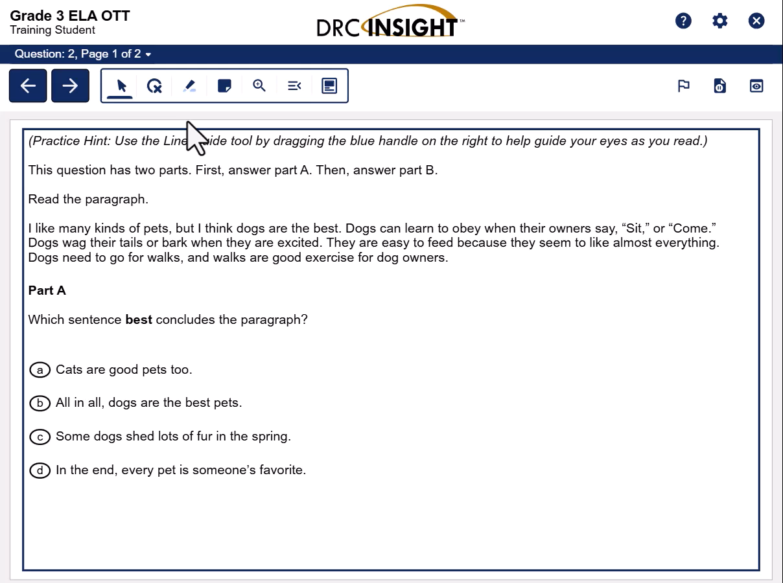
Tool Demo:
Highlighter
Notes:
Teacher: Press play for video.
Video transcript:
To use the "highlighter" tool, select the "highlighter" button and then choose “use highlighter”. The "highlighter" tool appears as a highlighter tip when chosen. Click and hold, then drag the highlighter to select the desired information to highlight.
To remove highlighting, you can select the highlighted information to remove one highlighted piece or select the "highlighter" button and choose “clear all” to remove all the highlighting on the page. You do not need to clear highlighting to move forward on the test.
Select the "pointer" button to stop using the "highlighter" tool.

Slide 11
Optional Activity: Highlighter
Read the selected text. Use the highlighter to mark the main idea or important details.
Notes:
Teacher:
Provide students with copies of previously selected sample test questions.
Ensure that students have highlighters.
Read the question aloud and model your thought process as you highlight important ideas in the passage.
Repeat as necessary until your students understand how to use the “highlighting” strategy.

Slide 12

Notepad
Use the notepad tool to take notes as needed. You can take notes while you are reading or to help you think through your answer for a test item.
Notes:
SAY: Use the “notepad” tool to take notes as needed. You can take notes while you are reading or to help you think through your answer for a test item.

Slide 13
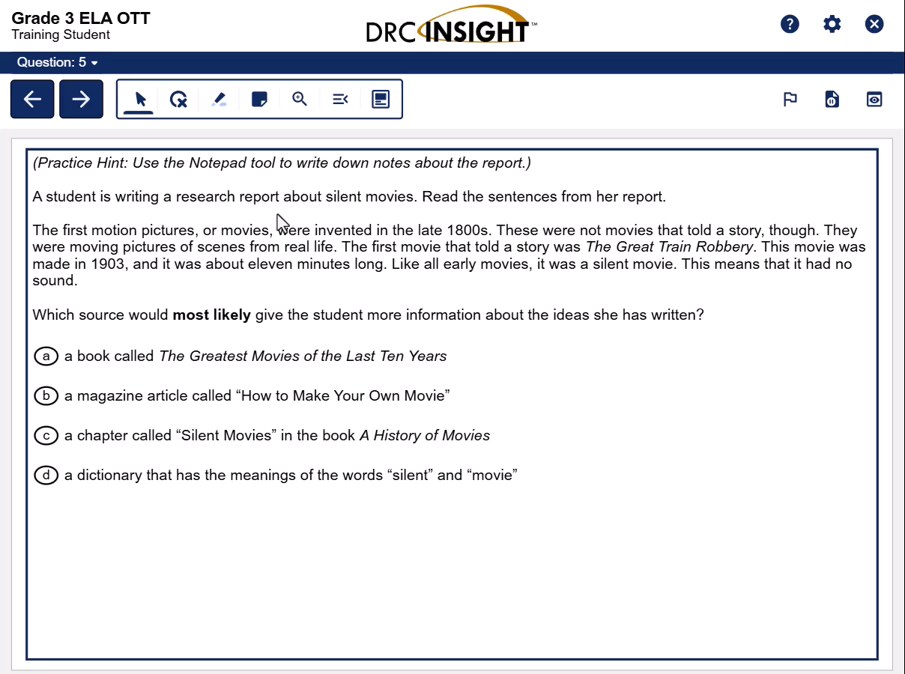
Tool Demo: Notepad
Notes:
Teacher: Press play for video.
Video transcript:
To use the "notepad" tool, select the "notepad" button. A textbox will appear on the screen. Enter text in the notepad using the keyboard.
To resize the notepad, select and drag the resize "notepad" button in the lower-right corner of the notepad to change the size of the text box. Select and drag the bar at the top of the window to move the notepad to a different location on the screen if needed.
To close the notepad, select the "close" button in the upper-right corner of the notepad or select the "notepad" button again. The information will remain in the notepad unless you delete it. Notice how the "notepad" button will change to a box with two lines once you have entered text to show that something is there. To reopen the notepad, select the "notepad" button again.

Slide 14
Optional Activity: Notepad
Use the notepad to type key words or main idea(s) from the selected text. Use your notes to answer the question.
Notes:
Teacher:
Provide students with copies of previously selected sample test questions.
Ensure that students have paper and writing utensils to make notes.
Read the question aloud and model your thought process as you write notes from the passage.
Repeat as necessary until your students understand how to use the notepad.

Slide 15

Magnifier
Use the magnifier to zoom in and see content larger.
Notes:
SAY: The "magnifier" tool allows you to enlarge the entire screen. You can use the magnifier to zoom in and see content larger.

Slide 16
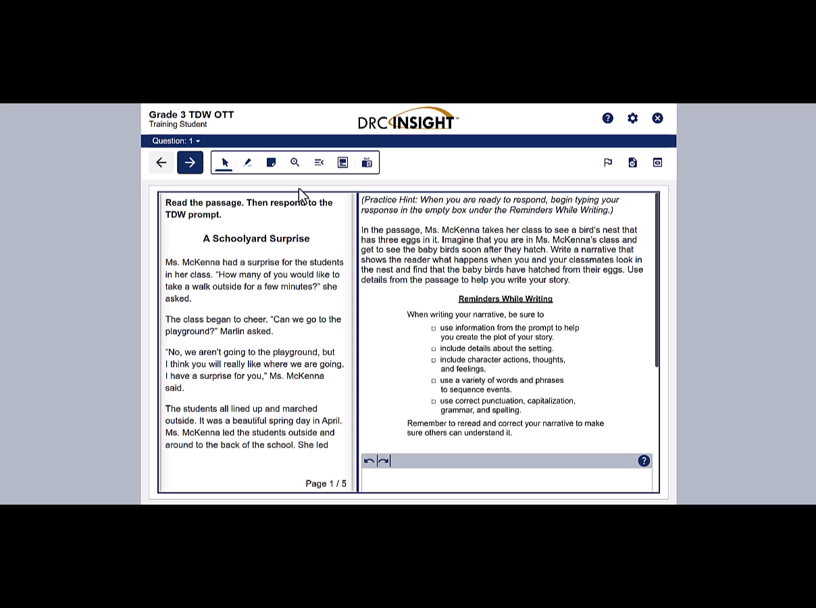
Tool Demonstration: Magnifier
Notes:
Teacher: Press play for video.
Video transcript:
To use the "magnifier" tool, select the "magnifier" button, then choose the level of magnification desired. For the purpose of this demonstration, I'm going to choose 3 times magnification. Scroll the window left and right or up and down to see the rest of the enlarged screen.
To stop using the "magnifier" tool, select the "magnifier" button again and then choose “off”.

Slide 17

Line Guide
Use the line guide to help you track lines in a passage.
Notes:
SAY: Use the "line guide" tool to help you track lines in a passage. The line guide can be used to bring focus to a single line or block of text.

Slide 18
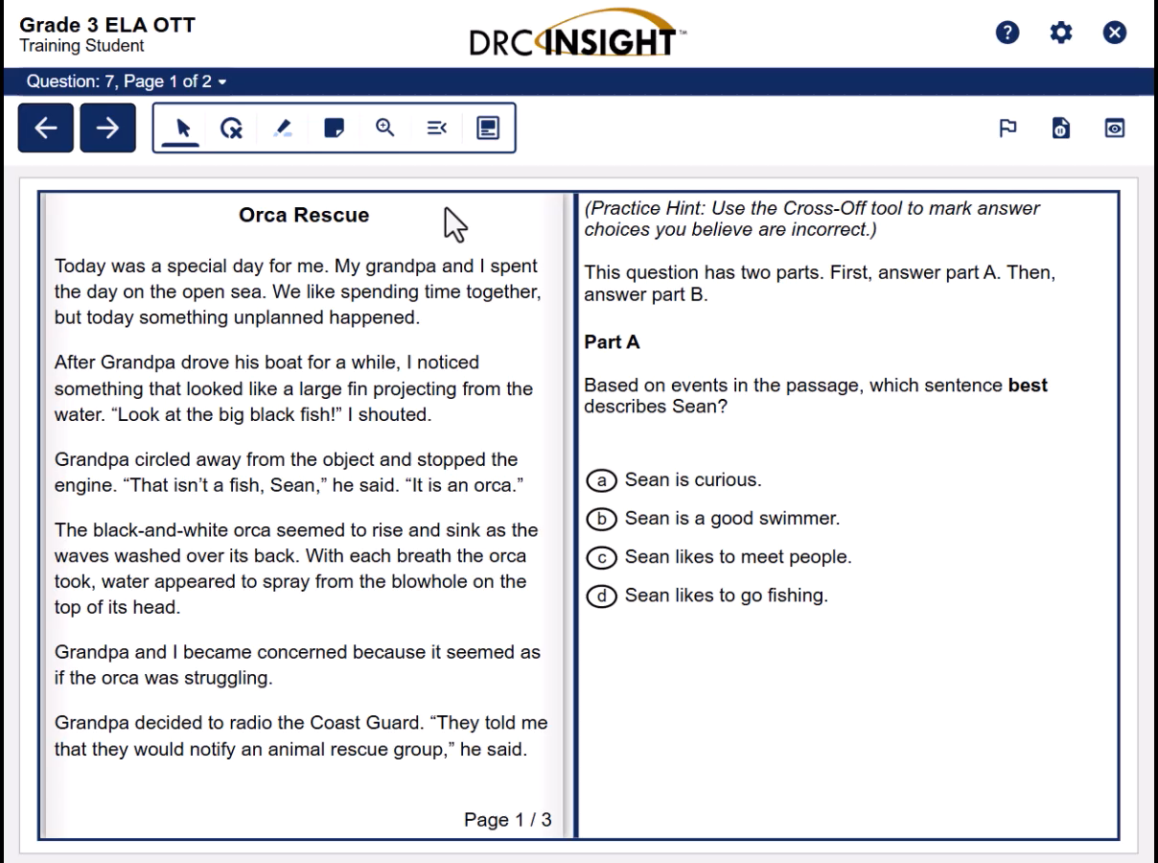
Tool Demo:
Line Guide
Notes:
Teacher: Press play for video.
Video transcript:
To use the "line guide" tool, select the "line guide" button. The line guide will appear as a solid line with a handle. Choose the line or the handle to move the line up or down. For questions that have multiple panes, you may select the line or the handle and drag the line guide from one pane to the other.
Select the "line guide" button to stop using the "line guide" tool.

Slide 19

Masking
Use the masking tool to cover part of the screen to help you focus only on the content that you choose.
Notes:
SAY: Use the "masking" tool to cover part of the screen to help you focus only on the content that you choose.

Slide 20
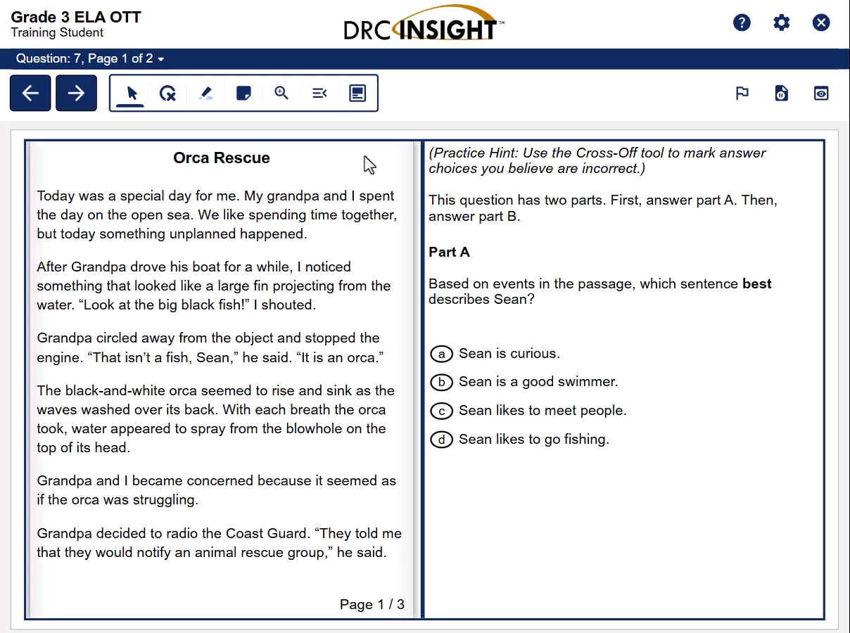
Tool Demo: Masking
Notes:
Teacher: Press play for video.
Video transcript:
To use the "masking" option, click on the "masking" button and then choose “add mask” to add a mask.
The mask will appear in the upper-left corner of the screen. You can move and resize the mask. To move the mask, click on the top of the box and drag the mask where you want it on the screen. To resize the mask, click on the bottom right corner, where you see two diagonal lines. This is the "resize mask" button. Drag the button to make the box larger or smaller.
To hide or unhide masks, select "masking" and then choose “show/hide masks”. This will cause the mask to disappear and reappear each time you click. You do not need to close the mask to move forward in the test.
Select the close button to close the "masking" window.

Slide 21
Optional Activity: Line Guide & Masking Tools
Use your line guide and masking tools to help you focus on specific lines or chunks of text as you read the paragraph.
Notes:
Teacher:
Provide students with copies of previously selected sample test questions.
Ensure that students have line guide and masking tools such as rulers, pipe cleaners, note cards, partial sheets of paper, etc.
Read the question aloud and model your thought process as you use the “line guide” and “masking” tools to focus on selected text.
Repeat as necessary until your students understand how to use the “line guide” and “masking” tools.

Slide 22
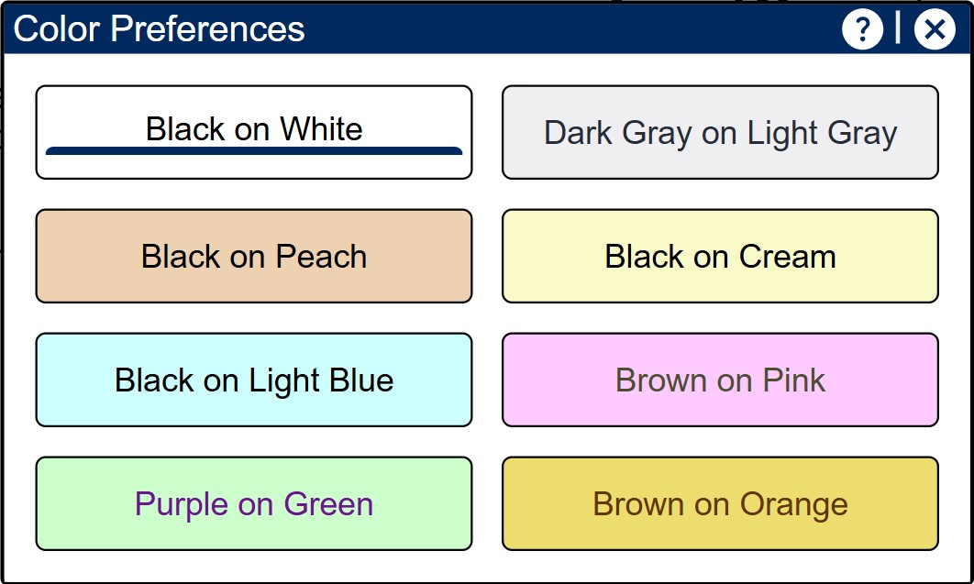
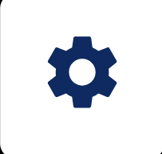
Color Preferences
Color Preferences allows you to change the background color and text color.
Notes:
SAY: The “color preferences” tool allows you to change the background color and text color. This may make it easier for you to read. Color preferences can be set by clicking on the options button in the upper-right corner of the screen.

Slide 23
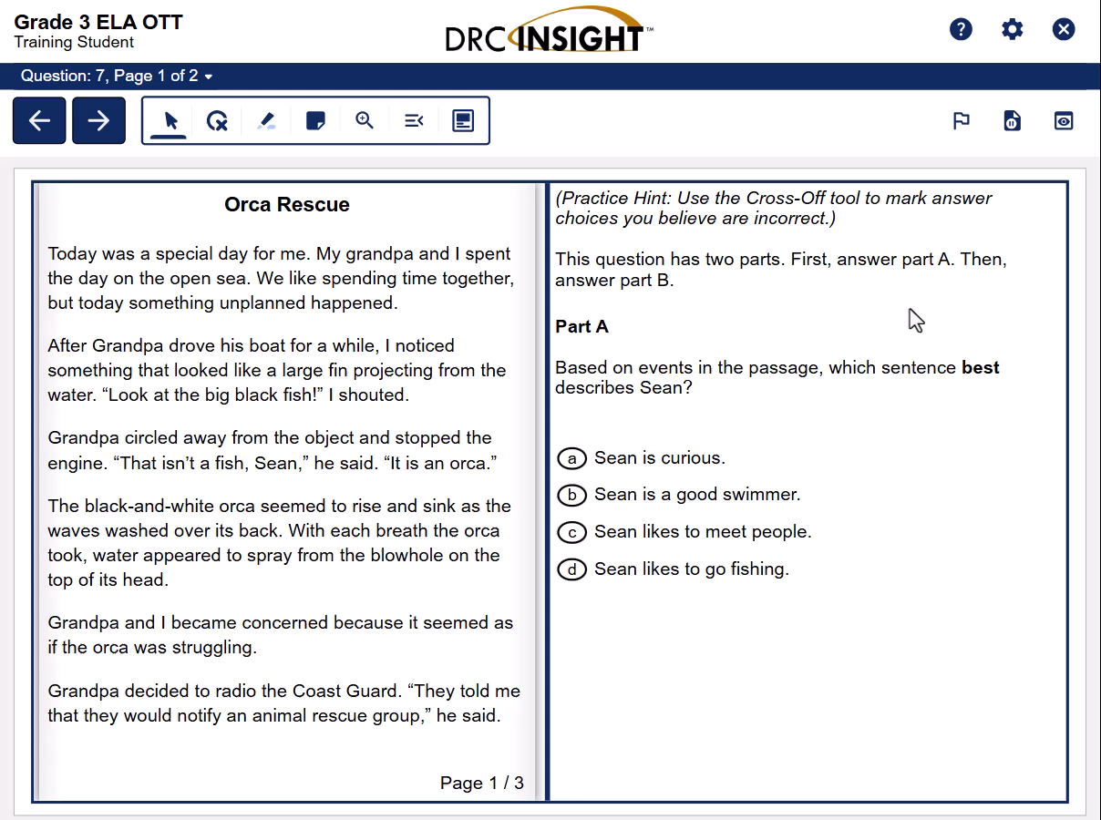
Tool Demo: Color Preferences
Notes:
Teacher: Press play for video.
Video transcript:
To change the colors on your screen, select the "options" button and then choose "color preferences". Select a desired color combination. The background color or text may not change for all parts of the screen.
The colors can be changed at any time during the test.
If you want to move the "color preferences" window, simply select and drag the bar at the top of the window to move it to a different location on the screen.
Click on the “x” to close the "color preferences" window.

Slide 24

Flag Question
Flag a question if you want to come back to it later.
Notes:
SAY: You can mark a test question with a flag so you can come back to it later.

Slide 25

Tool Demo:
Flag Question
Notes:
Teacher: Press play for video.
Video transcript:
To mark a question for review, click on the flag in the top right corner of the screen. The flag will turn red and will be underlined to show that the question is flagged.
To unflag the question, click on the flag again.
On the test review screen, you will see a flag next to the questions you have marked to review. Click on the question to go back and review your answer.
You can also go back into the test by clicking the “return to questions” button at the bottom of the screen. Once back in the test, you will see which questions are flagged by looking for the red flag in the top, right corner of the screen.
Flags do not need to be removed before ending the test.

Slide 26

References
Use the references tool to review the scoring rubrics for your writing.
*This tool is only available for the ELA Writing assessment.
Notes:
SAY: The "references" tool allows you to access the rubric for your writing test. It can help you make sure you have addressed all the key points to get the best score that you can.
Teacher Note:
This is only for Text-Dependent Writing (TDW) on SC READY 3-8 and English 2 EOC exams. It is not available for text-to-speech users, but it is offered in braille.

Slide 27
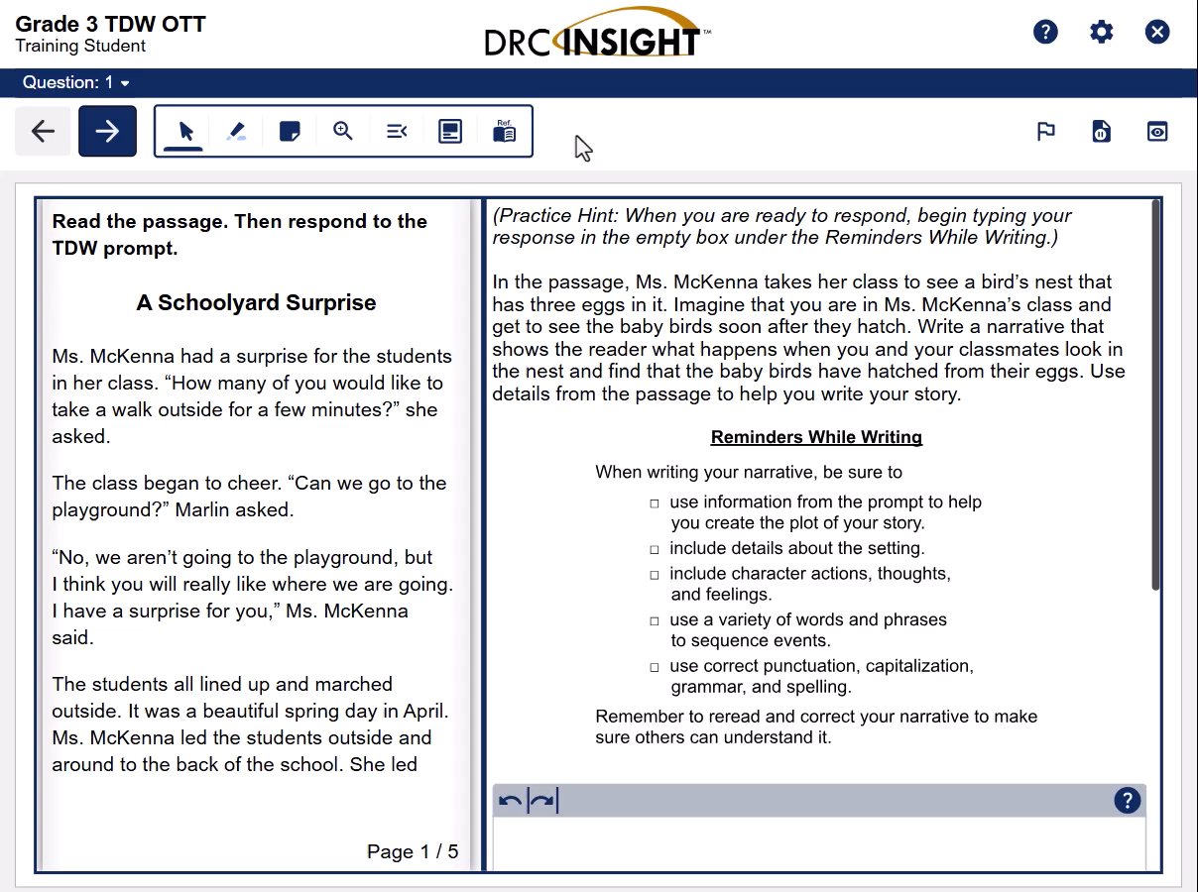
Tool Demo:
References
Notes:
Teacher: Press play for video.
Video Transcript:
To use the "references" tool, select the "references" button.
If more than one reference is available, choose the reference you want. Select and drag the bar at the top of the window to move the reference to a different location on the screen if needed.
To close the reference, select the "references" button and then choose the type of reference again or select the close button – the "x" at the top of the box - to stop using the "references" tool.
Teacher Note:
This is only for Text-Dependent Writing (TDW) on SC READY 3-8 and English 2 EOC exams. It is not available for text-to-speech users, but it is offered in braille.

Slide 28

Calculator
Use the calculator to solve equations.
For some tests, you will have the option to choose between a basic or a scientific calculator.
Notes:
SAY:
Use the "calculator" to solve equations.
Use the "scientific calculator" to solve more complex equations.
Teacher Note:
The basic calculator is available on Math (6th-8th) and Science (6th).
The scientific calculator is available on Math (6th-8th), Science (6th), Algebra EOC, and Biology EOC.

Slide 29
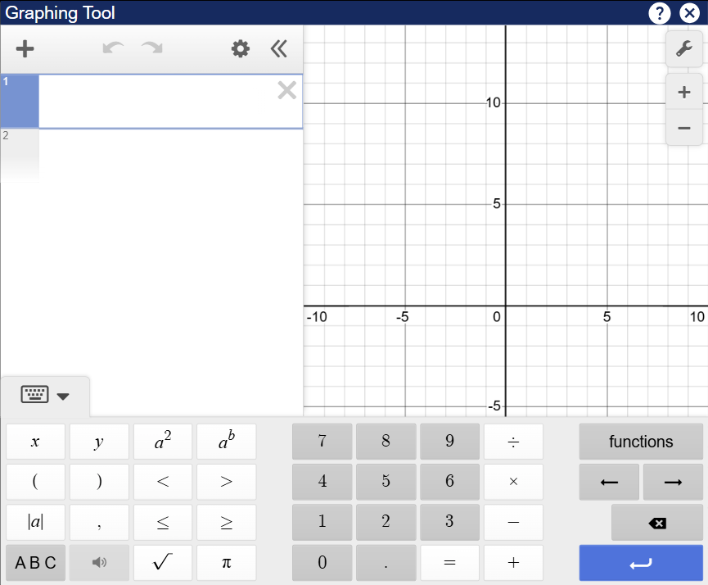

Graphing
Use the graphing tool to perform calculations and produce graphs.
Notes:
SAY: Use the "graphing" tool to perform calculations and produce graphs.
Teacher Note:
Graphing is available for Math (7th-8th), Algebra EOC, and Biology EOC exams.

Slide 30

Help
Use the help button to learn more about how things work in the test.
Notes:
SAY: The “help” button can provide you with more information about how to use online tools during the test.

Slide 31
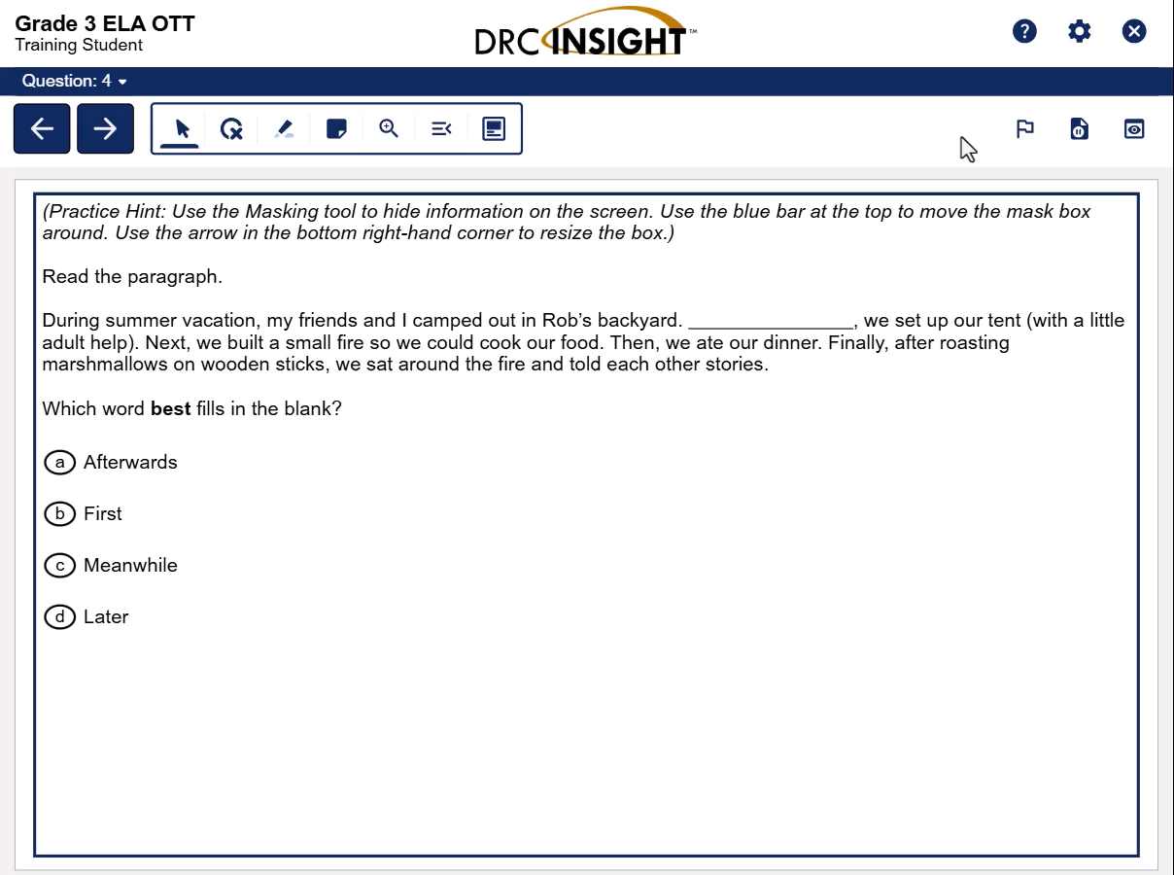
Tool Demo: Help
Notes:
Teacher: Press play for video.
Video transcript:
"Help" is available to you during your test. It has information to assist you with how things work. To use "help", select the "help" button in the upper-right corner of the screen and then choose "help" from the menu.
Across the top of the "help" window, there are tabs for different areas within "help". Once a tab is chosen, the left pane will list the topics available for that area. Once a topic is chosen, the content for that topic will be shown in the right pane of the "help" window.
You can also access the "help" library for some of the question types and tools by choosing the question mark icon in the upper-right corner of the screen. You can click the question mark icon that appears in the upper-right corner of the question type or tool. When you choose this icon, the "help" information for that question type or tool will be shown.
To close "help", select the "close" button in the upper-right corner of the "help" window.

Slide 32
Keyboard Only Access
Cross-off: Use Tab key to navigate, use Enter key to select/remove the cross-off
Notepad: Use Tab key to navigate; use CTRL + arrow keys to move the notepad window on the screen, to corner logo; use arrows to resize
Magnifier: Use Tab key to navigate to the magnification tool; use Enter key to open menu options; use Arrow keys to scroll through the magnification options; use Enter to select magnification level
Line Guide: Use the arrow keys to move the line guide up and down on the page
Masking: Use Tab key to navigate; use CTRL + arrow keys to move the mask on the screen, to corner logo; use arrow keys to resize
Calculator: Use Tab key to navigate to selection; use Enter to select option
Starting points: Use arrow keys to navigate a text selection; use enter to read from starting point; use enter to read question; use arrow keys to read answer choices
Notes:
Teacher Notes:
This slide includes tips for students who will be taking the test only using the keyboard and not a mouse/trackpad.
Hide this slide if it is not relevant to your students.
If you have students who will access this test using only the keyboard, please share this information with the student and instructional planning teams, as appropriate.

Slide 33
Final Thoughts
Online testing tools can help you work through questions to find the best answer.
You are not required to use the tools, but they are good test-taking strategies.
You do not have to close the tools to move forward in the test.
If you need more help learning how to use a specific tool, ask your teacher for support.
Notes:
SAY:
Online testing tools can help you work through questions to find the best answer.
You are not required to use the tools, but they are good test-taking strategies.
You do not have to close the tools to move forward in the test.
If you need more help learning how to use a specific tool, be sure to ask me.

Slide 34
Time to Practice!
Go to The SC READY Online Tools Training platform
Follow your teacher’s instructions to log on to the practice test.
Notes:
Teacher: After completing this online training, have your students practice using the online tools using practice tests available on the SCDE Assessment webpage.
Share this link with your students: https://portal.te.drcedirect.com/SC
Have students select the appropriate assessment.
Have students select “Online Tools Training”.
Have students select the appropriate subject to practice.
Have students select the appropriate assessment type (Standard, TTS, or VSL).
Have students select their grade level.
The practice session begins with several introductory pages that mirror the beginning of SC READY/EOCEP. Talk your students through this section. This is another opportunity to review which tools are available during the test.

Slide 35
ed.sc.gov
Notes:
Thank you!
If you have any questions about SC READY or EOCEP, please visit https://ed.sc.gov/tests/assessment-information/ or reach out to your District Testing Coordinator.

